Slide 1
Video Game Sales Analysis
McAndrew Saad
M2-W5

Slide 2
What is the business problem in question?

Slide 3
Launch a new sophisticated marketing campaign based on our sales data as a video games selling company
Find the platforms or Genres that are generating the most income
Finding out the taste of gamers around the world
Making new business deals with the top publishers

Slide 4
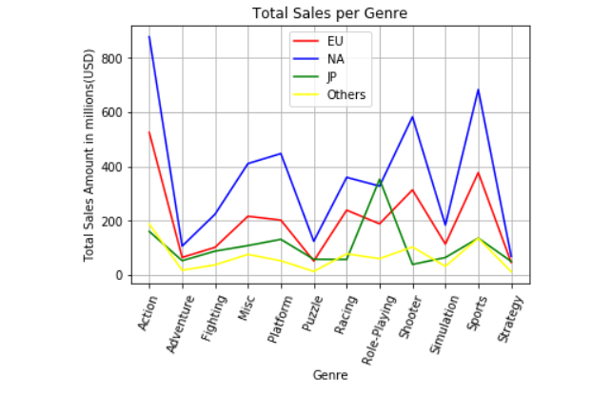
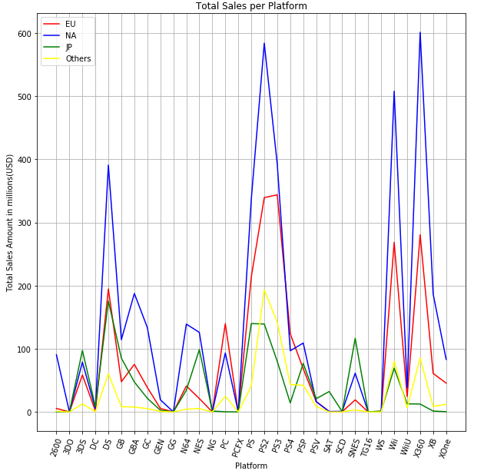
North America and EU Sales dominate the charts.
Reworking our marketing strategy over Japan and the rest of the world is a must.

Slide 5
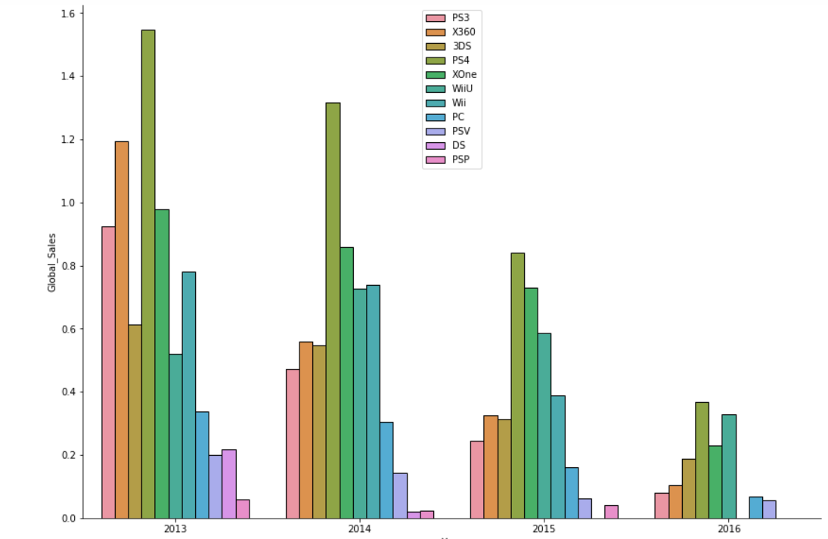
PS3/PS4 are generating the most income based on the past few years. Although the total seem to be going down from year to year but the PS remains on top.
Marketing wise, low sales platforms need a strategy adjustment.

Slide 6
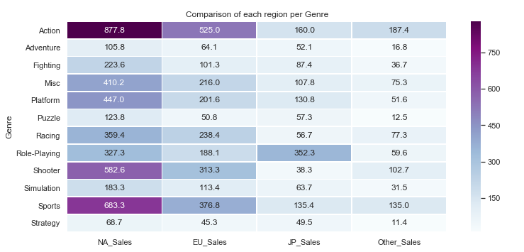
Action, sports and shooter games are generating the most income regionally.

Slide 7
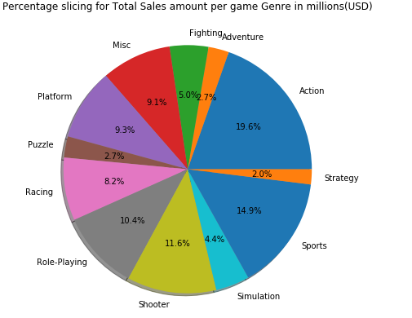
Clearly gamers’ preferences are towards Action and Sports games.

Slide 8
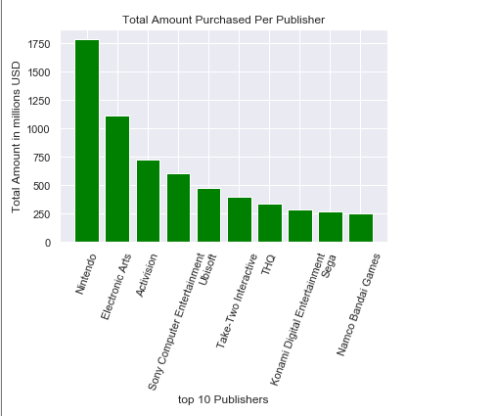
Nintendo and Electronic Arts are the publishers with the most sales.
Making better deals with publishers could be beneficial.

Slide 9
Conclusion
Action, shooter and sports games dominate any charts over NA and EU sales. Other categories have lower income over any region.
Marketing spend and strategy needs to be adjusted over the rest of the genres over all regions.
Make sure through our new marketing strategy that we keep high numbers for the top genres and platforms since they are generating the most income.

